Slide 1
How Can Objects Help Video-Language Understanding?
Presenter: Kim Seung Hwan (seunghwan.kim@snu.ac.kr)

Slide 2
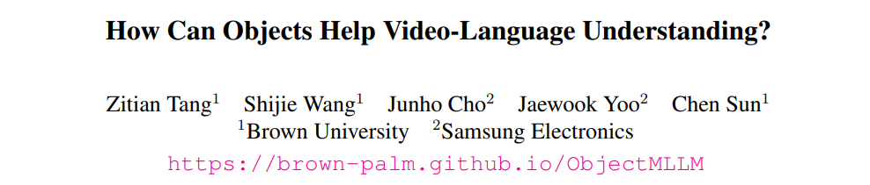
Paper
ICCV ’25
The results are more interesting than the method itself

Slide 3
Problem Setting
Video LLM tends to miss spatio-temporal information
And the key to this is motion
The basis is Johansson’s biological motion perception experiment

Slide 4
Problem Setting
On the other hand, there are two main ways to add new modalities to Multimodal LLM
Projection to the token embedding space through fine-tuning
Simply convert to text and inject

Slide 5
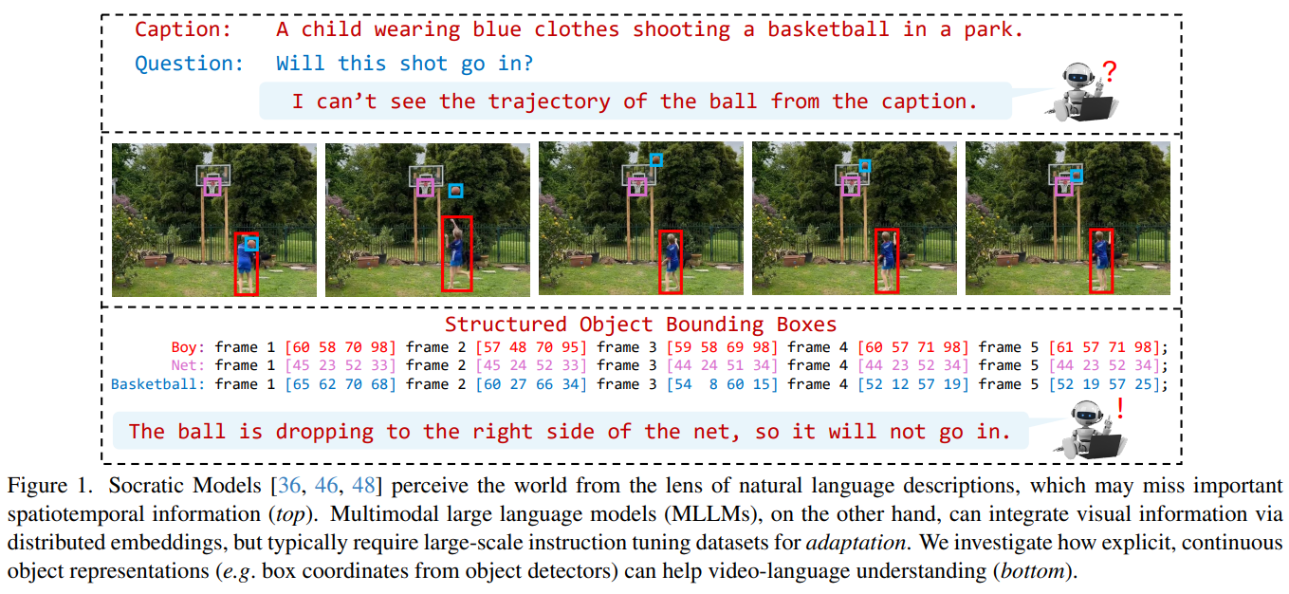
Problem Setting

Slide 6
Contributions
Improving video benchmark performance by injecting bounding box information
The experimental results suggest several implications for VLLM

Slide 7
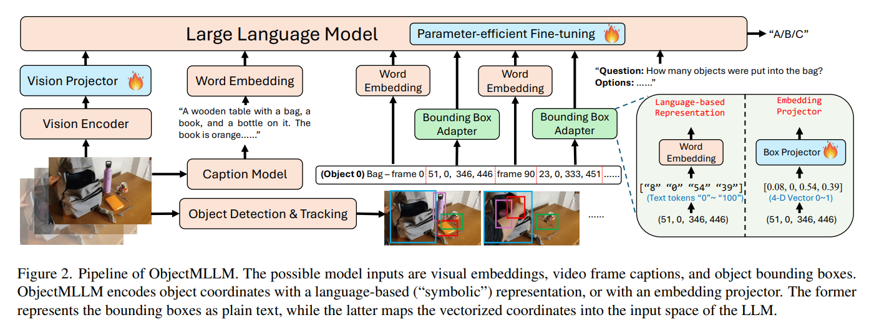
Method

Slide 8
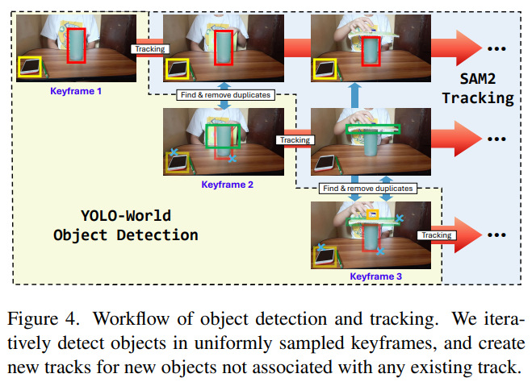
Method
Fine-tuned YOLO-World
For each dataset

Slide 9
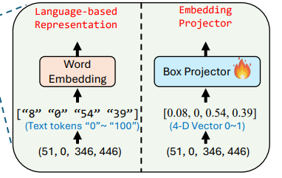
Method
Ablation of language injection and embedding injection
Language-based representation
Projection to embedding space

Slide 10
Experiment
Teach LLM new modalities
LLaMA3-8B + CLIP/VIT-L/14
Use another LLM (LLaVA) to generate captions
Boost Multimodal LLM by fine-tuning
VideoLLaMA2-7B

Slide 11
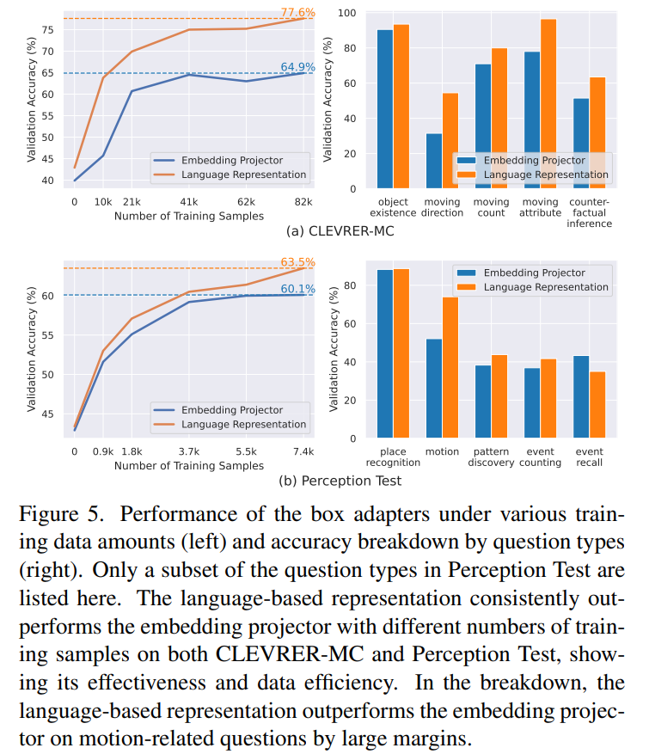
Results

Slide 12
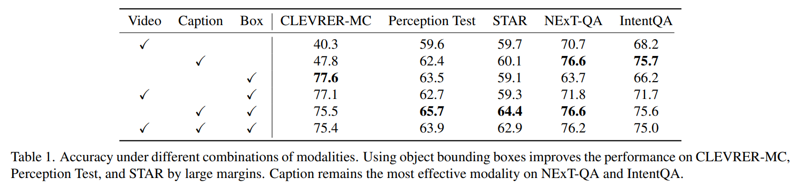
Results

Slide 13
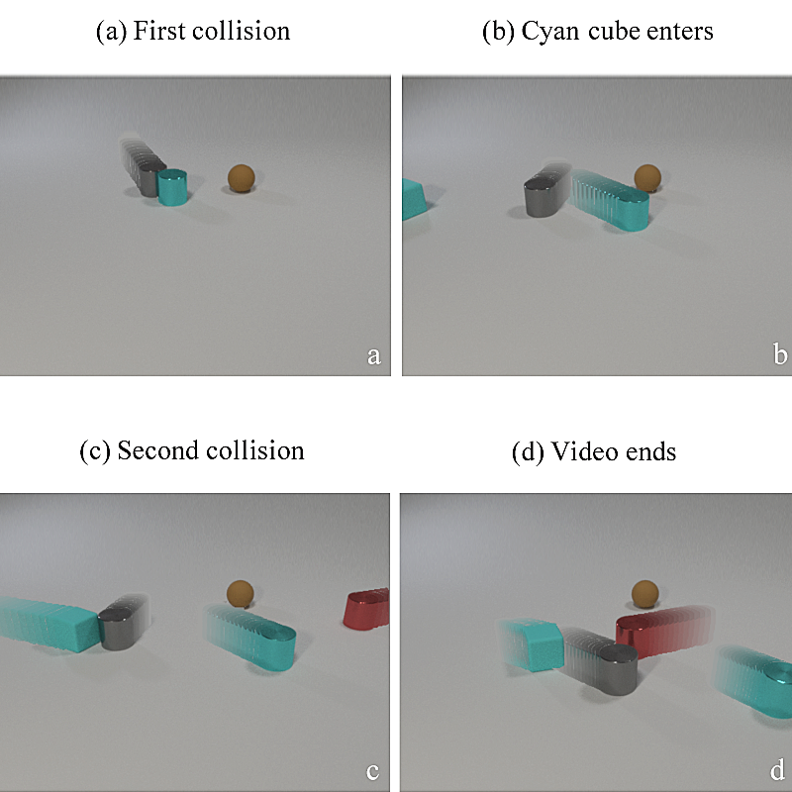
CLEVRER?

Slide 14
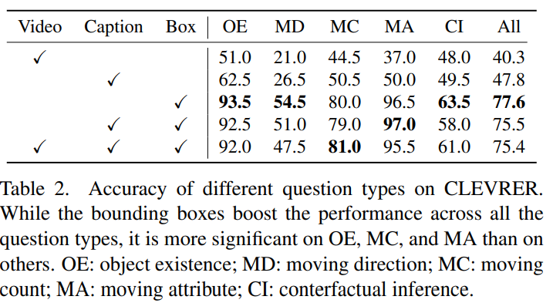
Results

Slide 15
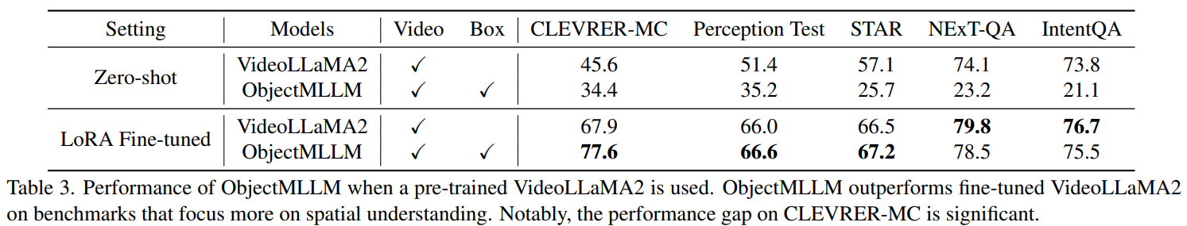
Results

Slide 16
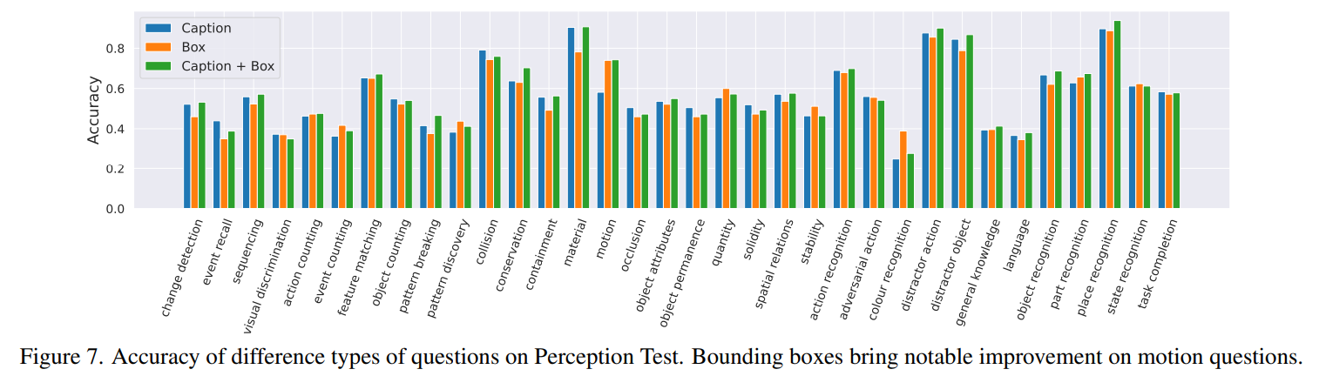
Results

Slide 17
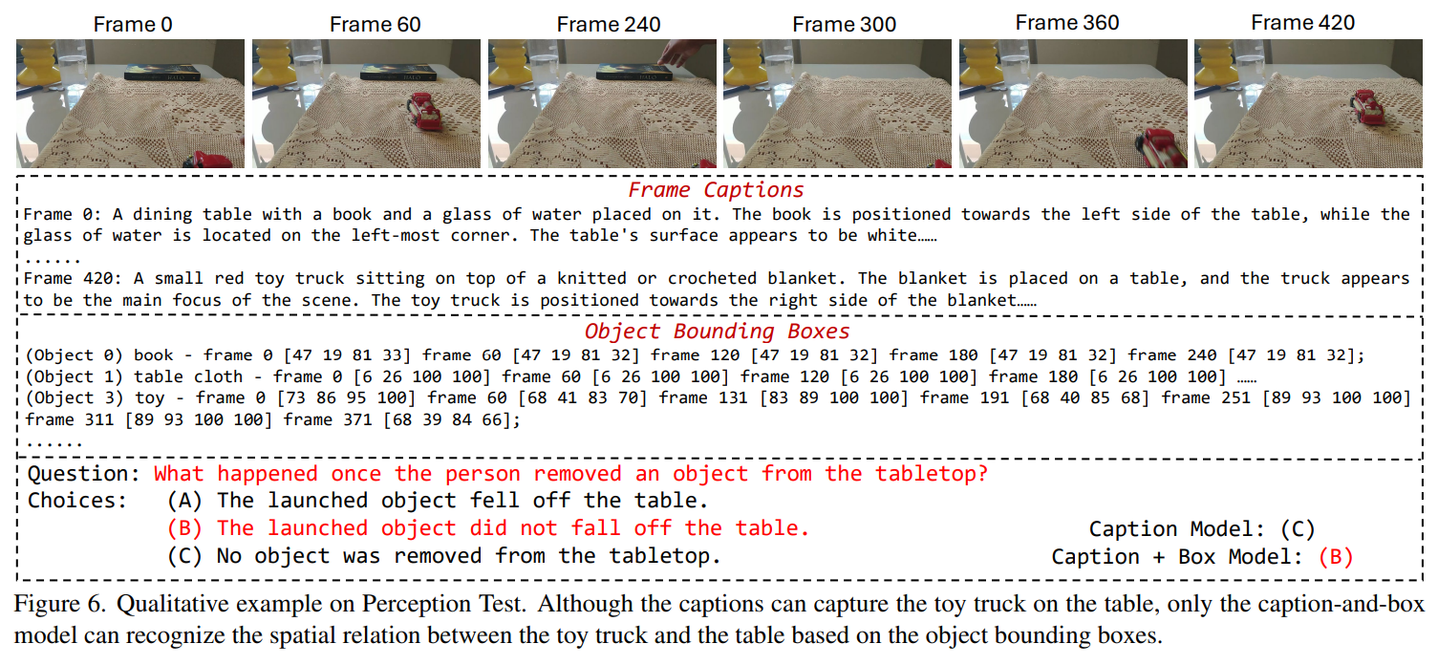
Results

Slide 18
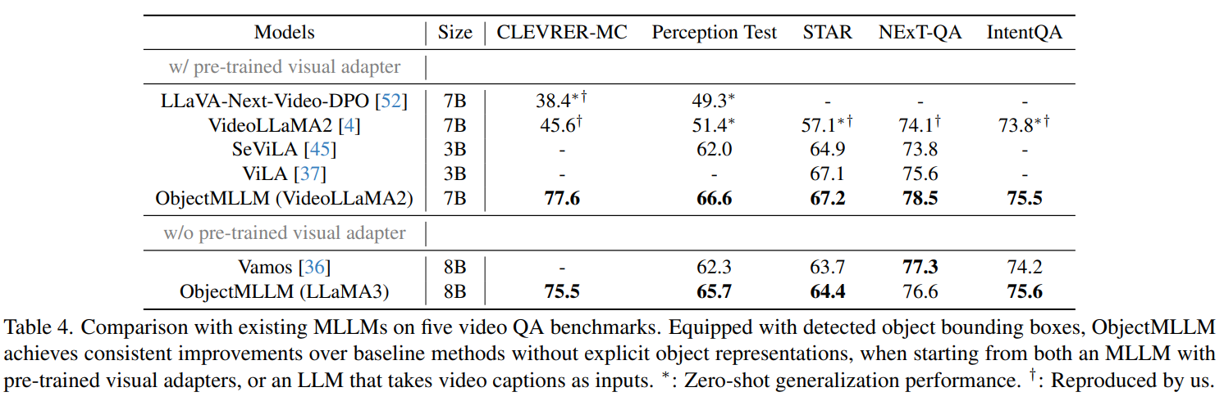
Results

Slide 19
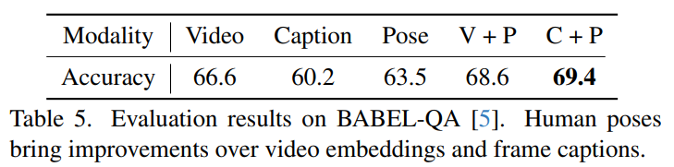
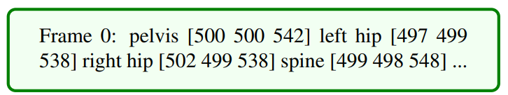
Results

Slide 20
Takeaways
Implicit (end-to-end training) vs. Explicit (strong human prior)
It is common sense that the former is information-rich, while the latter is data-efficient
But is the inefficiency of implicit learning so bad that it outweighs its richness?
Is it meaningful to add seemingly redundant information as text, like an extension to the human pose?
It seems to show the limits of parameter-efficient fine-tuning

Slide 21
Thank you for listening
Presenter: Kim Seung Hwan (seunghwan.kim@snu.ac.kr)

